Slide 1


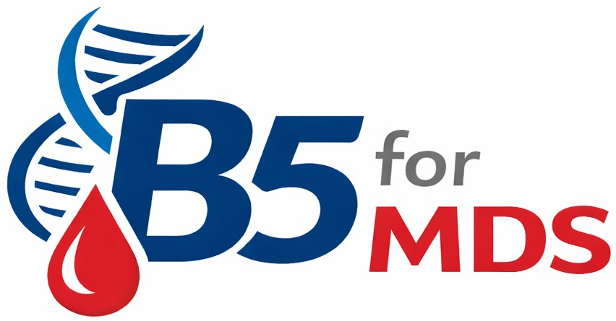
Dr. Oni Chowdhury
Consultant Haematologist and Senior Researcher
Oxford University Hospitals and University of Oxford
MDS UK meeting 16 June 2026

Slide 2

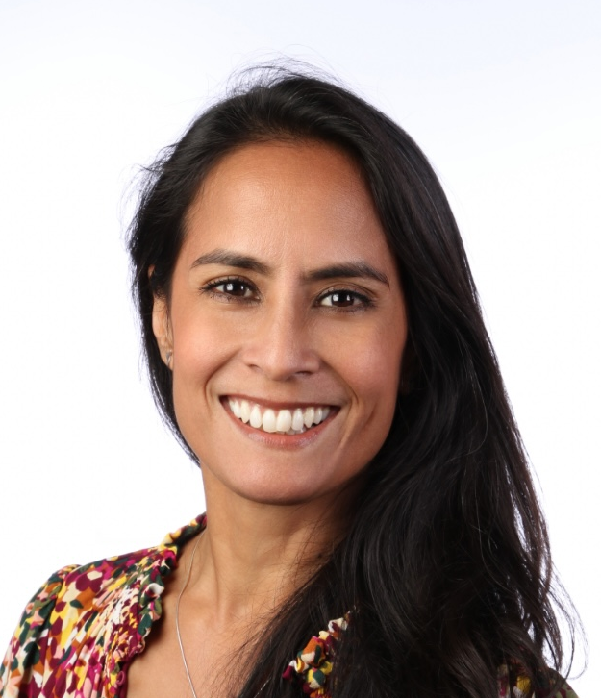
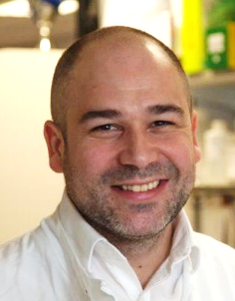


B5ForMDS: A single arm, phase II, multi-centre, Bayesian, intra-patient dose de-escalation trial to assess the activity of Vitamin B5 for the treatment of patients with SF3B1 mutant MDS
Dr Onima Chowdhury, University of Oxford
Dr Kevin Rouault Pierre, Barts Cancer Institute

Slide 3
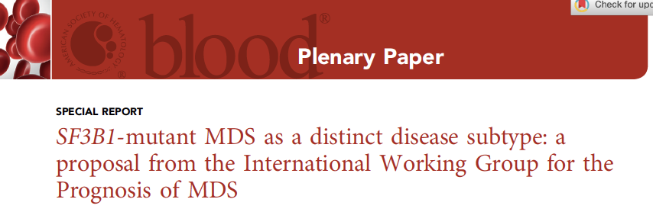
Key features of SF3B1 MDS
Commonest mutation in MDS
Severe anaemia
Transfusion dependence
Previously known as RA with ring sideroblasts
Lower risk IPSS-R and IPSS-M
MDS UK meeting • 16 June 2026
Notes:
What is aberrant splicing

Slide 4
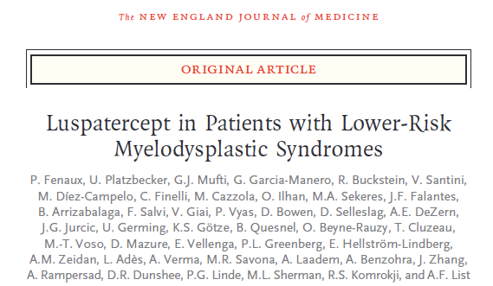
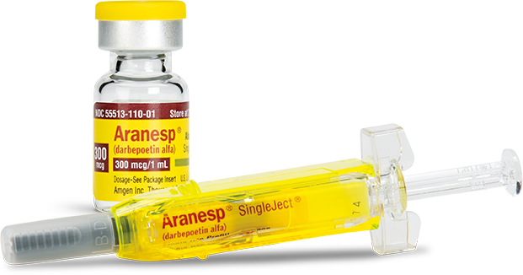
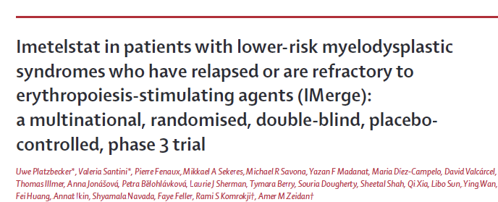
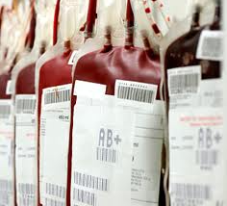

Treatment is limited to supportive care
Growth Factors
Transfusions
Clinical Trial
BSH recommendations. Killick et al, BJH 2021
ELN recommendations. Malcovati et al et al, Blood 2013

Slide 5
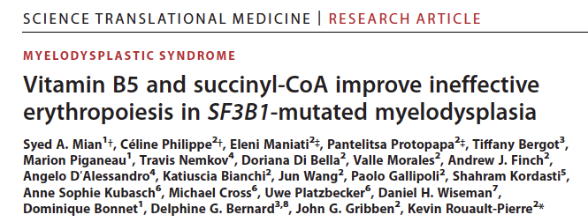
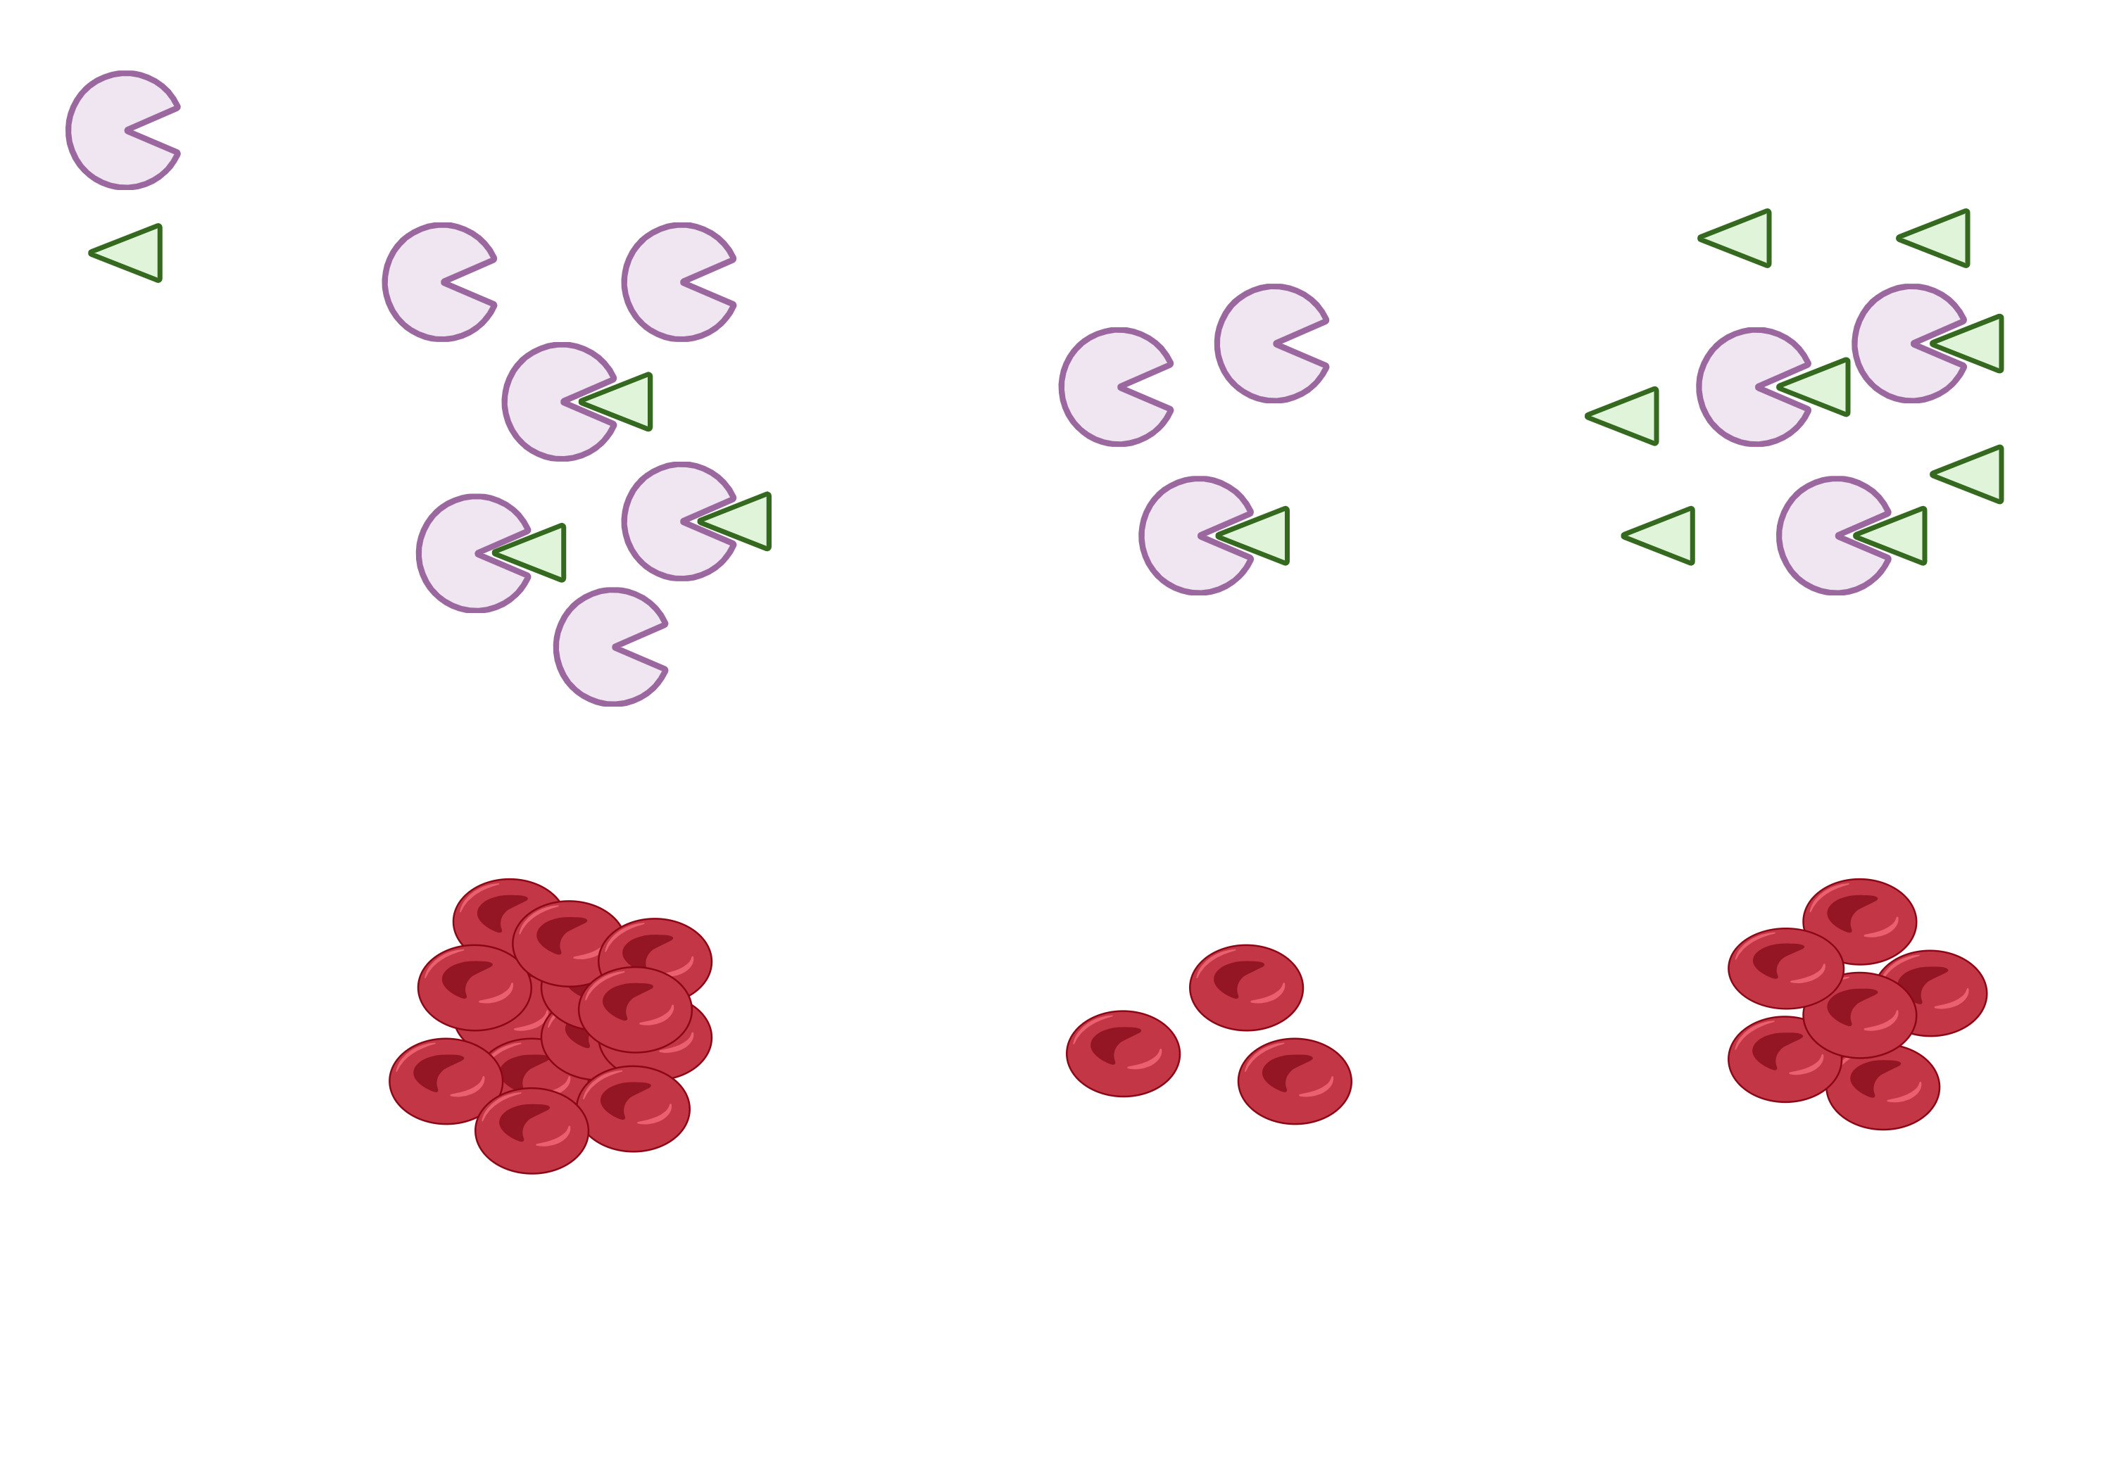
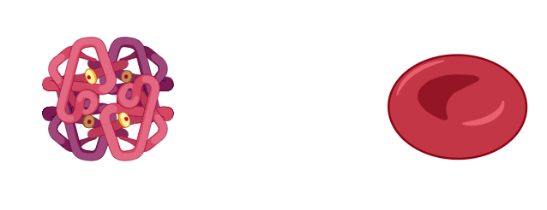
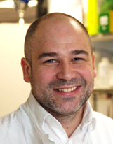
Precision Medicine for SF3B1 mutated MDS related anaemia
COASY
VitB5
Hb
RBC
Healthy individual
MDS patient + VitB5
MDS patient
COASY: Coenzyme A synthase
→50% reduction
Dr Kevin Rouault-Pierre, Queen Mary University of London

Slide 6
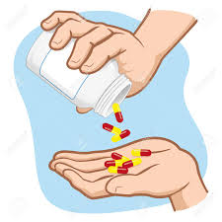

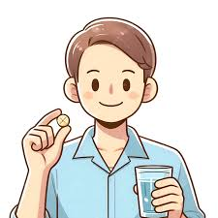
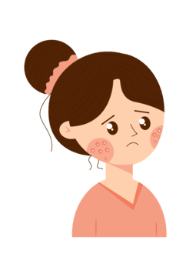
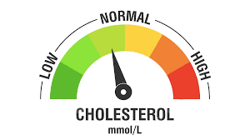

Minimal side-effects
VITAMIN B5
Tablet
Lowers cholesterol
Helps with acne
Found in small amounts in a variety of foods
MDS UK meeting • 16 June 2026
Notes:
Water soluble: Widespread function - breakdown fats, carbohydrates and proteins for energy production; Critical for red cell production; cholesterol synthesis; skin health
Recommended daily intake 5mg
Not routinely measured
Side effects from increased intake - diarrhoea
Skin and cholesterol trials which rely on same mech action

Slide 7

Study timelines
2027-2030
Spring/ summer 2025
Autumn/Winter
2025
Jan/Feb
2026
2025
Trial under development with the University of Birmingham CRCTU.
Funding applications submitted.
Wait on outcomes while continuing to refine design.
Funding Success!
Recruit 1st patient within 1 year - trial will be recruiting for 2 years in total.
MDS UK meeting • 16 June 2026

Slide 8
Could Vitamin B5 help anaemia in SF3B1-mutated MDS?
1
Who can take part?
2
What is involved?
30 Adults with MDS and an SF3B1 mutation
Recruiting through 7 UK haematology centres
Vitamin B5 tablets with regular blood tests
and symptom / quality-of-life checks
3
What do we hope to see?
What matters most?
4
Higher haemoglobin and fewer red cell transfusions
Safety, tolerability and whether people feel better day-to-day
MDS UK meeting • 16 June 2026

Slide 9
Patient partnership in B5ForMDS
How people living with MDS are shaping the trial design, conduct and reporting.
Grant application
Patient documents
1
2
Co-developed with people who have MDS
3 patient representatives helped develop patient-facing documents
Advisory group
Ongoing input
3
MDS UK is helping set up a Patient Advisory Group of 5-6 patients or family members.
4
The group aims to meet at least every 6 months during design, conduct and reporting.
Trial governance
Day-to-day trial management
5
6
A patient representative will sit on Trial Steering Committee.
Another patient representative will join the Trial Management Group.
MDS UK meeting • 16 June 2026

Slide 10
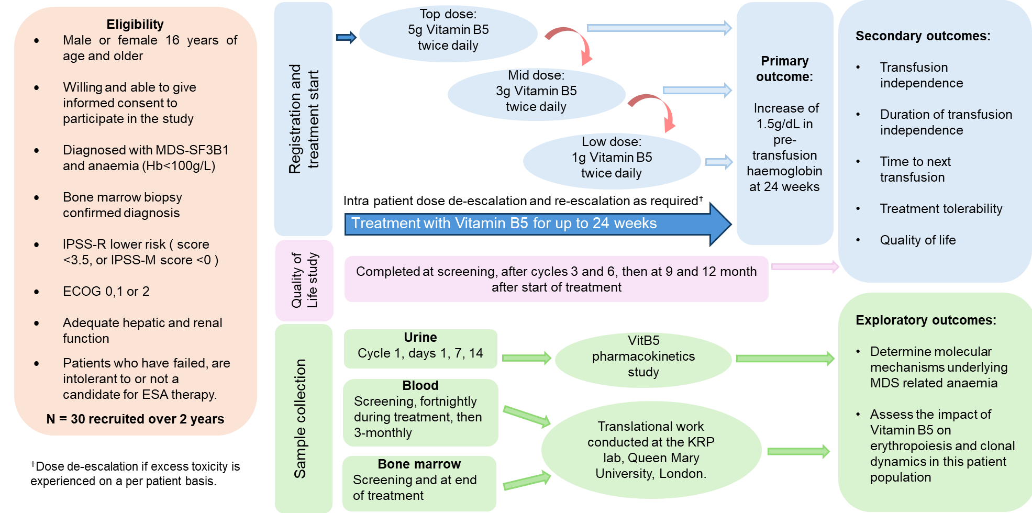
Schema

Slide 11
Schema

Slide 12
Schema

Slide 13
Schema

Slide 14
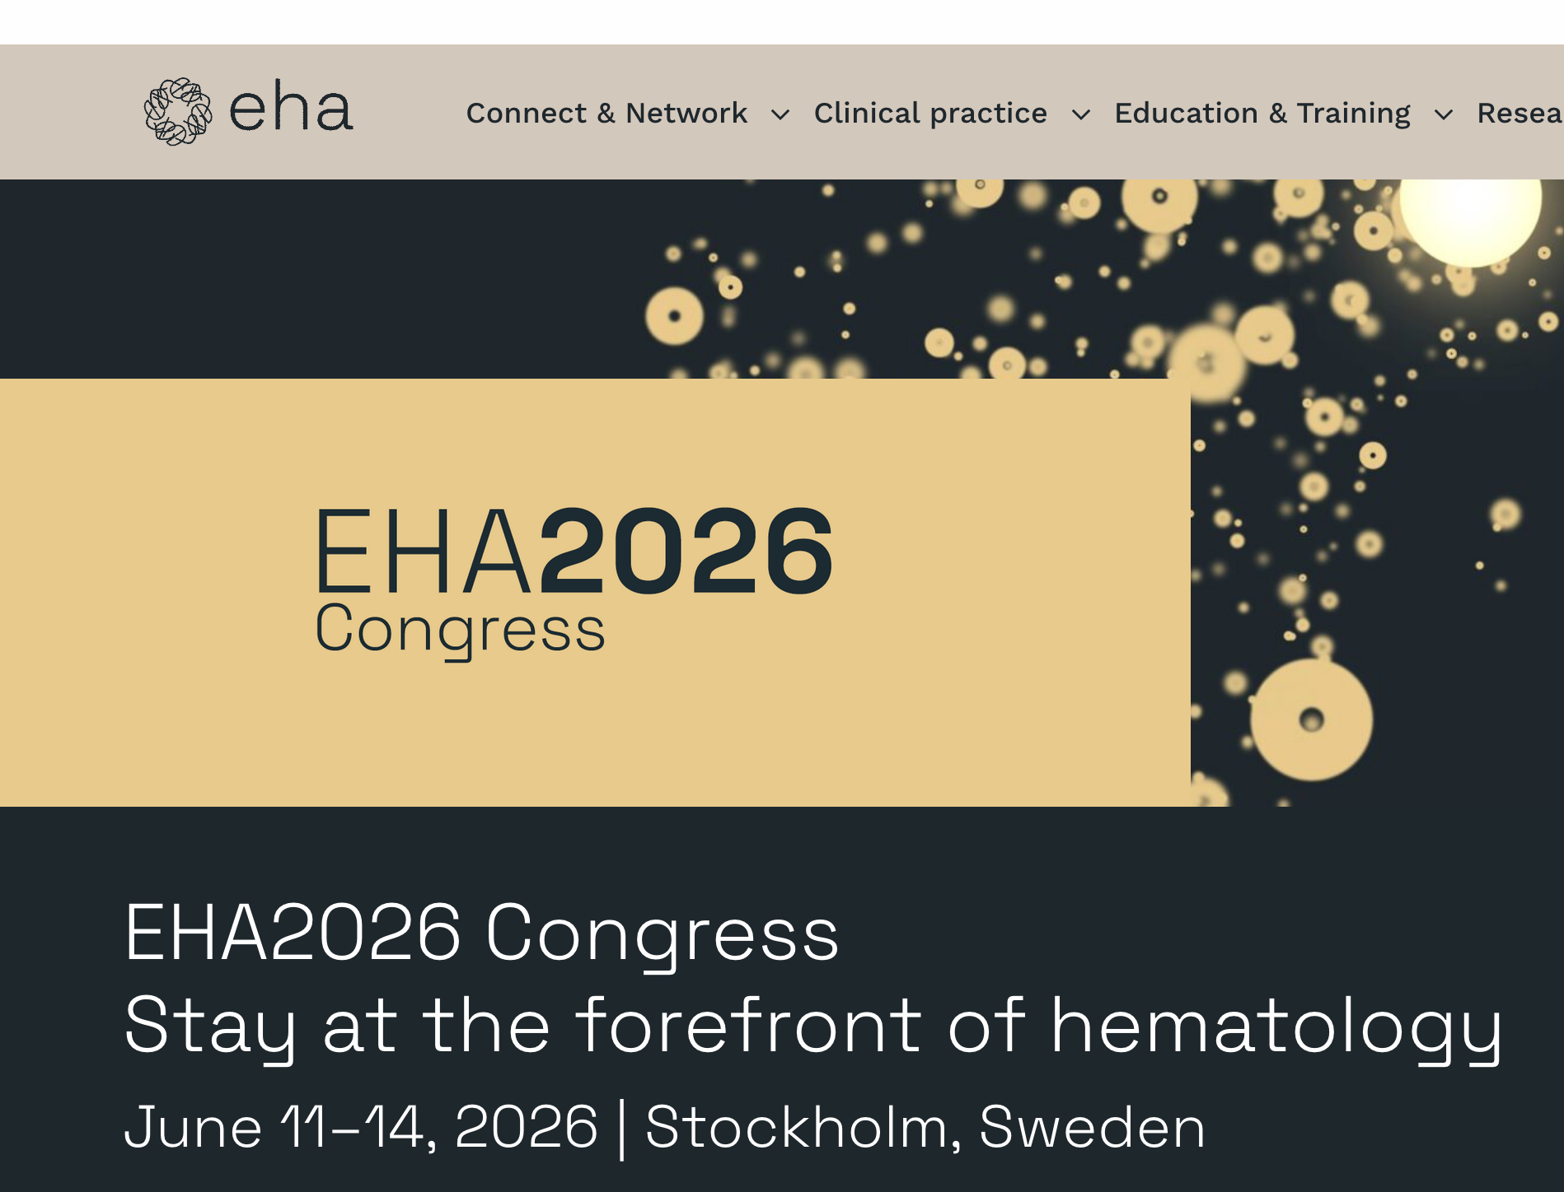
Thank you very much
Happy to take questions

