Slide 1
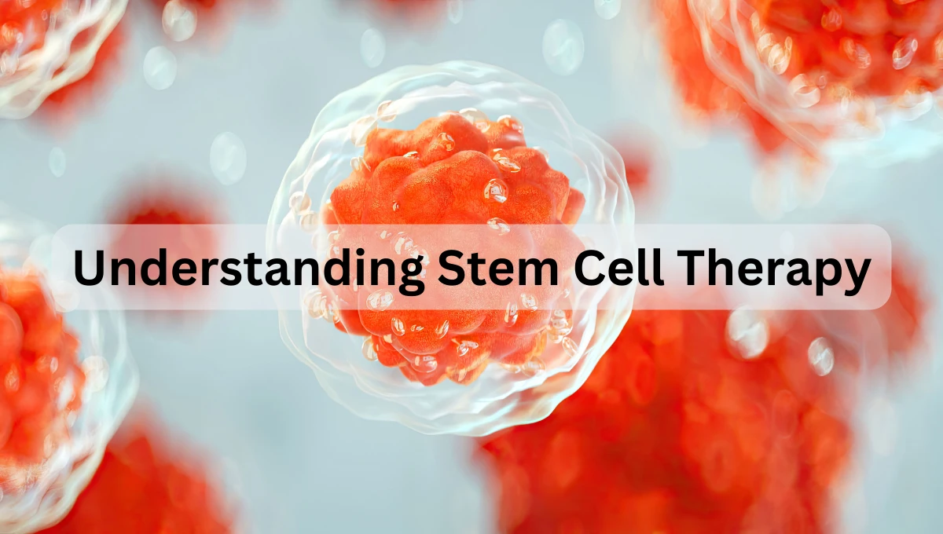
What to expect before, during, and after transplant
What to expect before, during, and after transplant

Slide 2
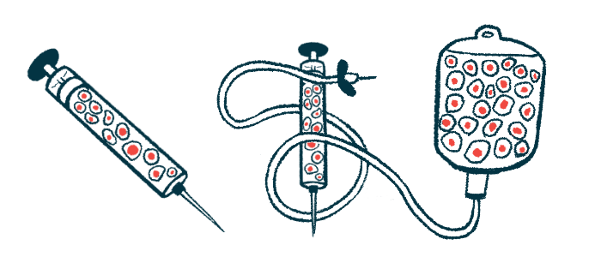
Why a Donor Stem Cell Transplant?
Also called allogeneic/ allograft stem cell transplant.
Replaces damaged or non-functioning bone marrow with healthy stem cells from another person (donor).
Restores healthy blood cell production and help rebuild the immune system to fight the disease.

Slide 3
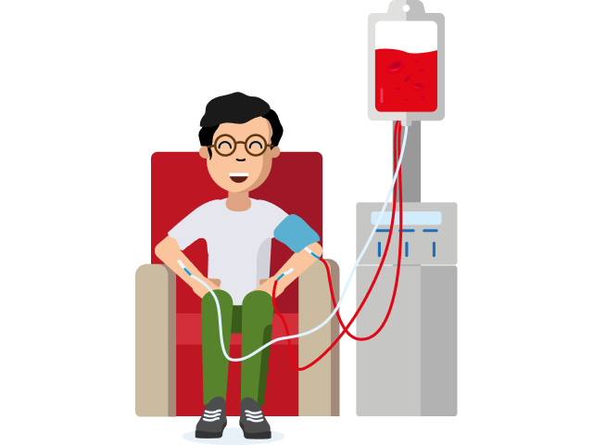
Considerations
 | Diagnosis: High‑risk Myelodysplastic Syndrome (MDS); Acute Myeloid Leukaemia (AML); Myelofibrosis (MF); Chronic myelomonocytic leukaemia (CMML); Myeloproliferative neoplasms (MPN); Aplastic Anaemia (AA)
 | Disease status
 | General Fitness
 | Organ function: heart, lungs, liver, kidney
 | Other pre-existing medical conditions
 | Donor availability
Notes:
Disease Status: Dependent on disease response to initial treatment . Relapse risk. Explored all other treatment options.

Slide 4
Preparing for the Transplant
Meet your transplant team
Detailed assessment and tests (heart, lung, kidney, liver, dental, fertility).
Lifestyle adjustments
Tissue Typing (patient and relatives)
Donor identification and matching
Discussion with Multidisciplinary team
Stem cell infusion (D0)
Conditioning (chemotherapy ± radiotherapy)
Transplant Consent

Slide 5
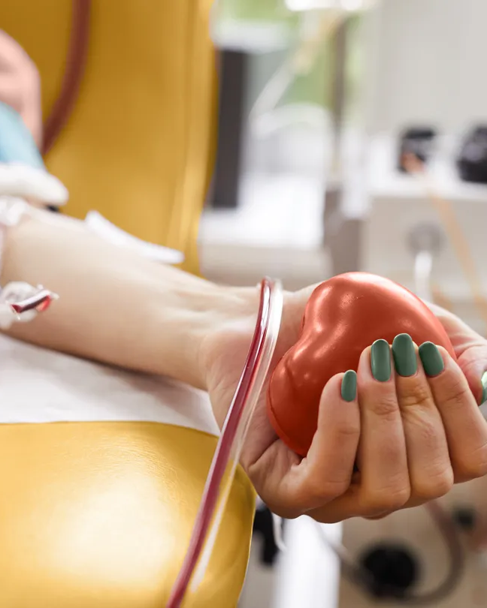
Donor Search and Selection
Types: Related donors (siblings, children, parents), unrelated donor, cord blood;
Matching is based on human leukocyte antigens (HLA);
Donor search can take days to months;
Donor considerations: age, gender, ABO group, CMV status, health screening.

Slide 6
Pre-Transplant Work-up
01
04
02
05
03
06
ECHO
GFR NM (glomerular filtration rate to assess Kidney function)
CT Thorax
Fertility counselling and preservation
Lung Function Test
Pre transplant virtual patient session

Slide 7

Admission & Conditioning
5-7 days of chemotherapy - Conditioning
D+5 ward admission if on Ambulatory pathway
Ward Admission
(for 4-6 weeks) or
Ambulatory Pathway
Wait blood
count recovery
Regular follow ups monitoring for side effects; immune recovery; counselling and support to return to daily life.
Hickman Line
insertion
Stem Cell
infusion Day 0
Discharge
preparation
Side effects of Chemotherapy; infection risk, close monitoring
Notes:
Admission
Intensive chemotherapy (sometimes with radiotherapy) given to remove diseased marrow and suppress the immune system so donor cells can grow (engraft)
Regimens will vary depending on disease, age and clinical situation (myeloablative vs reduced‑intensity conditioning).
Regular blood tests and supportive care (antibiotics, transfusions) are common.

Slide 8
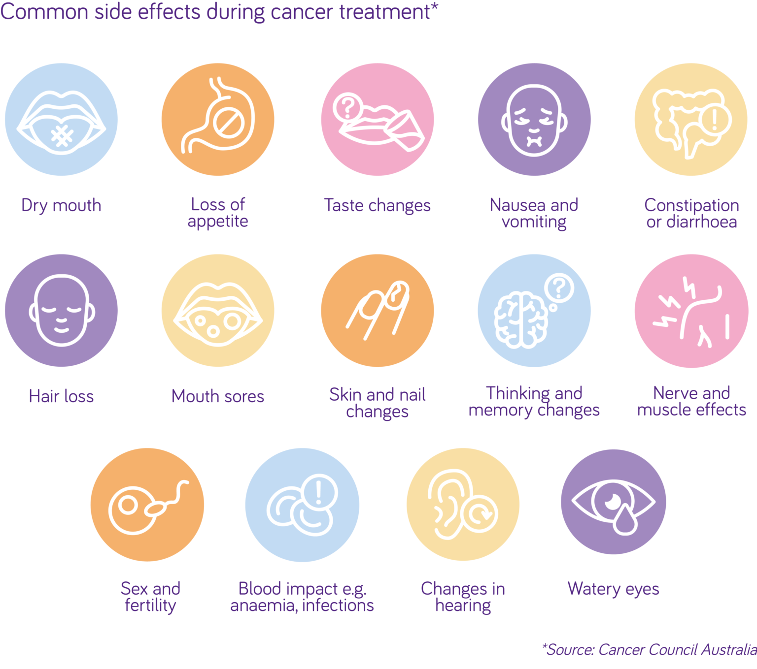
Chemotherapy Possible Side effects

Slide 9



Post-Transplant Care & Follow-Up
Frequent clinic and supportive therapy visits (Initially twice weekly for the first 2-3 months, then gradually less often)
Multiple Medication (immunosuppression, prophylactic antibiotics)
Possible Readmissions
Close monitoring – Infections (viral, fungal, bacterial); Acute and Chronic GvHD
Bone Marrow Biopsies

Slide 10
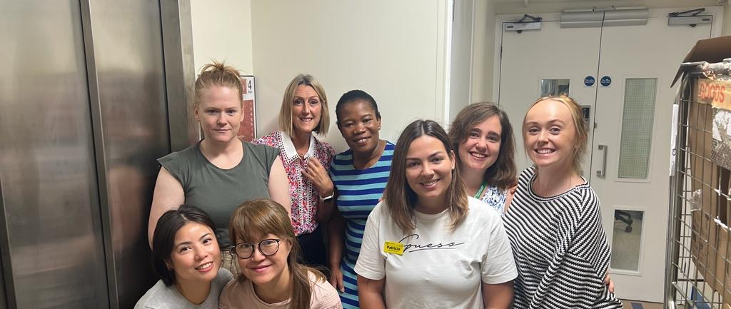
The Transplant Team at Kings

Slide 11
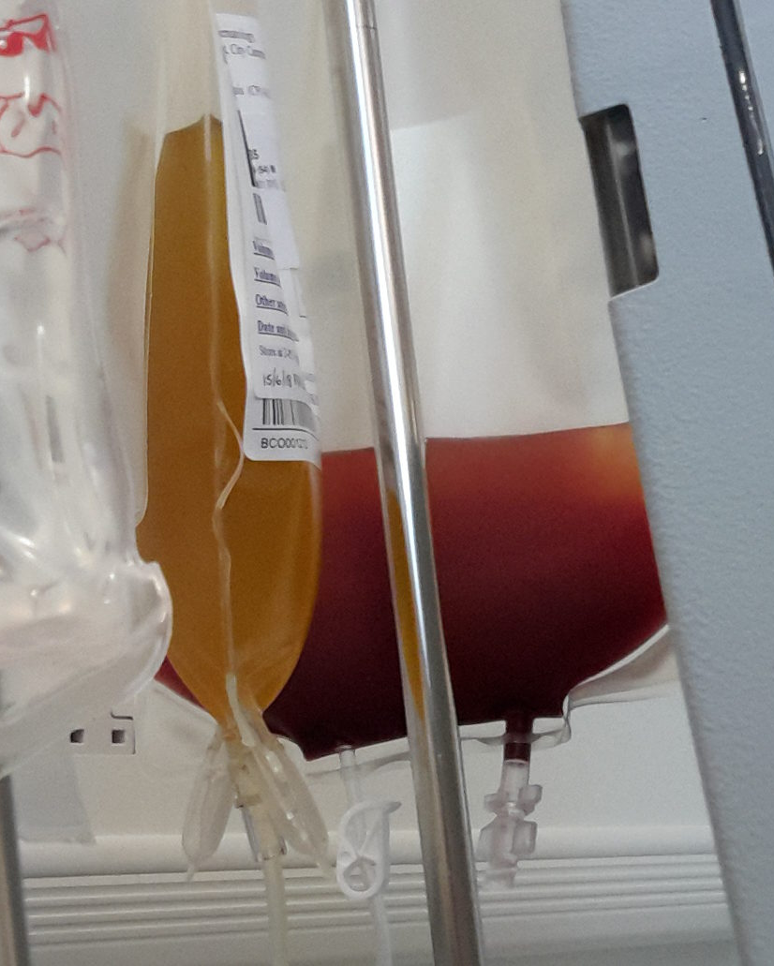
Thank You
Questions?
Patricia.cardoso1@nhs.net
Bone Marrow Transplant Coordinator Clinic Nurse Specialist
020 3299 5268

Slide 12
Resources
Blood stem cell and bone marrow transplants: The seven steps. (n.d.). Available at: https://cdn.shopify.com/s/files/1/0196/7004/0676/files/Blood-stem-cell-bone-marrow-transplants-seven-steps-seven-0617.4.pdf?v=1609858498
The Seven Steps The Next Steps A handbook for long-term recovery after a stem cell transplant. (n.d.). Available at: https://www.anthonynolan.org/sites/default/files/2021-08/1981PA_Next7Steps2021_DIGITAL.pdf
Macmillan (2019). Cancer Information and Support. [online] Macmillan.org.uk. Available at: https://www.macmillan.org.uk/cancer-information-and-support

